Slide 1
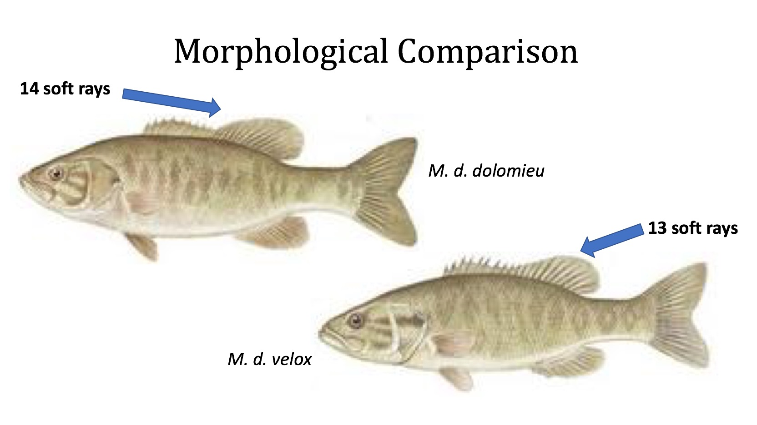
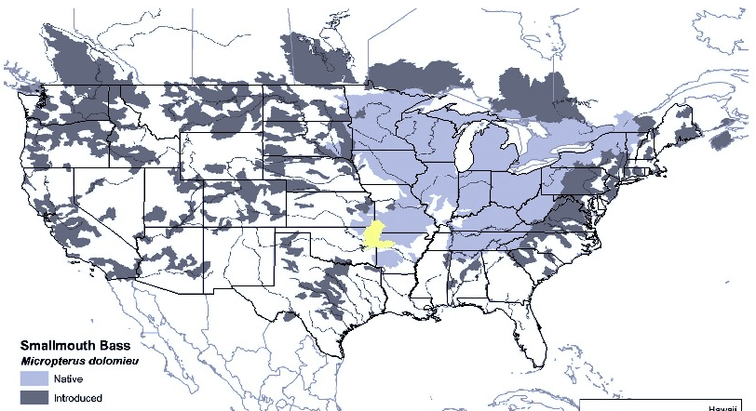
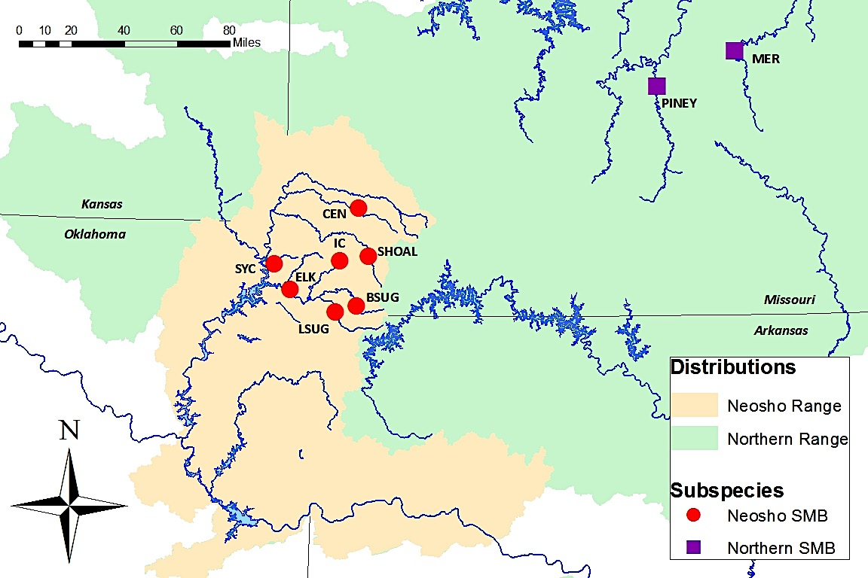
Validating the Taxonomic and Distributional Status of the Neosho Smallmouth Bass (Micropterus dolomieu velox)
Joe Gunn, Leah Berkman, and Lori Eggert
University of Missouri
Smallmouth Taxonomy
Taxonomists currently recognize two Smallmouth Bass (Micropterus dolomieu) subspecies: the Northern Smallmouth Bass (M. d. dolomieu, top left) and the Neosho Smallmouth Bass (M. d. velox, bottom right)
Subspecies Distributions
Smallmouth are endemic to the eastern U.S., but M. d. dolomieu and M. d. velox have unique native habitats; velox is restricted to the Interior Islands (yellow shaded region at left), while dolomieu inhabits the northeastern portions of the range (light gray shaded region at left)
Our Question: Are M. d. velox and M. d. dolomieu valid subspecies?
Methods
We are collecting fin clip samples and several morphometrics, including total length, standard length, orbital length, head length, body depth, and soft dorsal ray count, from tributaries throughout the native ranges of M. d. velox (shaded yellow at right) and M. d. dolomieu (shaded green at right). By analyzing differences in the genetic structure of both populations and comparing our results to the subspecies’ morphological distinctions, we will be able to determine whether these current subspecies constitute valid, unique taxonomic variants.
We are grateful for funding through the Missouri Department of Conservation

